Slide 1
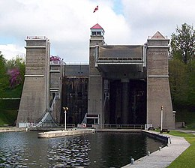
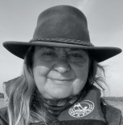
TRENT SEVERN CHAPTER
JUNE 2023

Slide 2
PRESIDENT’S MESSAGE
We look forward to seeing you at our luncheons, bus trips and our golf tournament. Our second luncheon of the year will be at Square Plates, 836 Armour Road, Peterborough for noon on Wednesday, July 12, 2023. We also plan to have a luncheon in Lindsay at Neabors Family Restaurant, 401 Kent Street West for noon on Thursday, August 10, 2023. The Golf Tournament at Deer Run Golf Course in Little Britain on Saturday, September 16th is attached for your registration. We’re still planning a bus trip from Belleville to a Riverboat cruise to explore the Peterborough Liftlock and the Otonabee River on Wednesday,October 4, 2023 followed by a buffet dinner at Chemong Lodge. Email Bob bdwludyka@gmail.com. Price is $130.00, $50.00 deposit on reservation and balance of $80.00 cheque post dated for September 1st.More details to follow on our next newsletter. We will have our annual meeting and luncheon in November in Peterborough and of course you can always attend the monthly lunches in Belleville as organized by Bob Wulduka. The next monthly luncheon is Monday, June 26, 2023, Noon at the Northway Restaurant, 205 North Front St. For any of our events it’s important to book with us as soon as possible.
Continued…

Slide 3
Continued…
I've just returned from our National AGM in Vancouver, a cruise to Alaska from May 20-27, which afforded us ample time to bond as Presidents. Our meetings were held when we were at sea leaving time to explore the ports of Juneau, Skagway, Glacier Bay and Ketchikan. What I did find out is that the Vancouver Heritage Club always has a couple of spots available at a discounted price through their President, Fred Danells contact fwdanells@hotmail.com
We haven't reached our summer solstice yet we've experienced, an April ice storm, record breaking temperature highs, fires, smokey skies, and heavy rains so that we’ve not been sure what to wear when we leave the house but hopefully, sunny skies will stay to dip our toes in the lake or travel in our beautiful country.
Robin O’Donohue, 416-899-7259
trentsevern.heritageclub@gmail.com
Read more on our website at www.heritageclub.ca/trentsevern

Slide 4
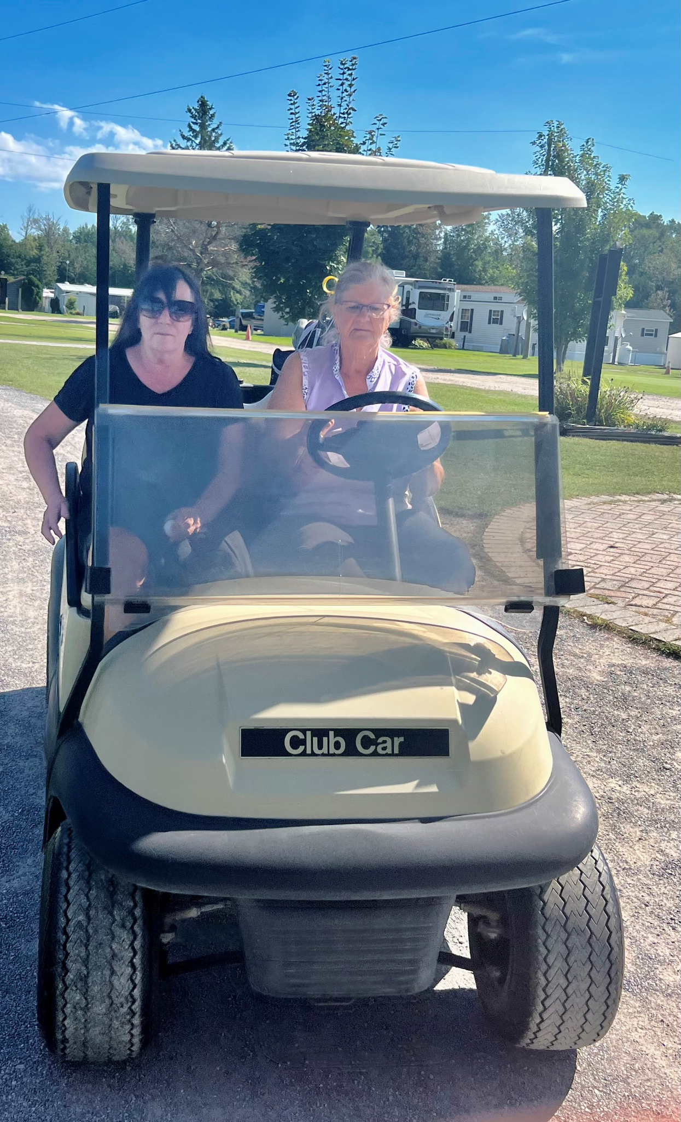
TRENT SEVERN HERITAGE CHAPTER CHARITY GOLF TOURNAMENT
INCLUDES: 12 HOLES WITH CART/DINNER–2:00 P.M.
Grilled Hamburger / Pasta Salad / Garden salad with Poppyseed Dressing / Dessert, Coffee, Tea
PRIZES! PRIZES! PRIZES! Cost: $75.00 EACH
PUTTING CONTEST 3 BALLS FOR $5.00
50% TO WINNERS / 50% TO CHARITY
CONTACT: PHYLLIS KIMMERER @ 705 320-9480 OR pdkimmerer@hotmail.com
PLEASE REPLY BY AUGUST 10th, 2023
SATURDAY, SEPTEMBER 16, 2023 11:00 A.M. – Shotgun Start
DEER RUN GOLF COURSE 10 BROOK STREET, LITTLE BRITAIN, ON, K0M 2C0 TEL: 705 328-3781 (8 KM SOUTH OF HWY #7 ON ELM TREE ROAD SOUTH OF THE FLASHING LIGHT)

Slide 5
Community Foundation, Santa, Charities
Community Foundation
We have an opportunity to assist with the evaluations of community based organizations who have applied to Canada Post for funding up to $25,000. Guidelines are provided for the process and each person is given ten applications to review. It's a very interesting and user friendly process so I just need volunteers to assist. This occurs in late winter/early spring for volunteers.
Santa Letter Writing Volunteers
Congratulations to Dianne Wludyka for winning $50.00 from The Santa Letter Volunteer Winner Draw!
Heritage Club has been involved since it was established in 1989, almost 35 years, of which 5 Billion have been answered in total. Last year 189,117 letters were answered by 551 Volunteers! This is what we do best.
Life Events
Let us know if there are any special events coming up that we could share with our chapter. A simple email or text would suffice.
Charities 2022 Lakefield and Lindsay Food Bank Women’s Resources of Kawartha Lakes - for abused women and their children. Kiwanis Boys and Girls Club - Lindsay

Slide 6
Who and What we do:
Who we are:
Trent Severn Chapter is one of 24 chapters across Canada. Trent Severn Chapter encompasses the land of lakes, rivers and locks of Ontario’s best cottage country, rural cities and towns. It represents all of Northumberland, Hastings, Haliburton, Kawartha, and Muskoka areas. Most of our social activities are focused in Belleville, Peterborough, Lindsay and Barrie.
What we do:
Trent Severn organizes subsidized luncheons and an Annual Golf Tournament for our members. We also support the local food bank and give donations to our targeted charities throughout the year.
The motto of the Heritage Club is “People Helping People”:
We would like to know of any activity you are currently volunteering which benefits people and/or the community and how many hours you spend per month. This is one of the criteria we are measured on by Canada Post and it affects our funding. Please contact me with any volunteer work you wish to share.
Heritage Club Scholarship Campaign 2023
This program ends June 30th and continues each year, especially now with the grant increased to $2,000.00. Our national website will direct you to the application process, or contact Eldred Holmes at holmes@nl.rogers.com
Johnson Insurance Scholarship Campaign 2023
50 scholarships of $1,000.00 each is awarded and submission deadline is July 27, 2023. Details at scholarshipfund@johnson.ca

Slide 7
Belleville Council
Bob Wludyka heads the council chapter in Belleville. Along with his executive and volunteers he organizes and participates in a great many functions. Some of which are as follows:
Monthly lunches and Bus trips, 50/50 draws
Beer cans and liquor bottles drives – For charity
Pop can Tabs and Bread Plastic Tabs
As well as other charity drives
He has also been responsible for
establishing the Belleville Postal Museum. Bob is enthusiastic about sharing ideas and events in the Belleville area.
Any of our dues paying members, who would like to join in any of Bob’s functions, contact him by phone or e-mail.
bdwludyk@gmail.com or 613-986-3874

Slide 8
FROM THE TREASURER’S DESK
We are continuing to request members to pay for their 2023 dues. Our funding from the Head Office is based on the number of paid members. The more paid members we have, the more funding we receive to build our chapter. This means we can support our charities and our members by offering subsidized lunches and events. It's only $10.00 per year and the good news is that we have made it easier to pay via e-transfer, cheque, or cash. Our website has an easy information change form https://heritageclub.ca/member-information-change/ An hard copy renewal form is included for your convenience. Please complete the questionnaire and return with your payment to the Treasurer, payable to:
Trent Severn Heritage Chapter
E-transfer: ssmithcanpost@gmail.com with password as follows: “Trentsevern22” for e-transfer or call (416) 523-7398 Mail to: 18 Sinclair St. Lindsay, On. K9V 5C9.

Slide 9
Newsletter and Membership
Newsletter Distribution
This newsletter is produced four times a year and is distributed to every member and associate who has paid the annual dues to the Chapter for that year. Also, a general distribution is made once a year to every person currently listed as retired, or has 25 years of service in our Chapter area.
Associate Members
Associate membership is available to the interested spouses of current members, and
to surviving spouses of deceased members who wish to continue to receive
correspondence, participate in activities, and keep up with news from their friends in the Club.
Paid up Associate members will be issued their own membership number. If you wish to take advantage of this opportunity, please let me know.
Membership Advantages
● Johnson Auto Insurance: exclusive savings up to 35%.
● Discounts for travel through Medoc Insurance Travel.
● Goodlife Fitness: Discounts of 30% off the regular access rates.
www.goodlifefitness.com Please note that you must purchase your membership on-line, not at the gym, and you will require your Heritage Club number to access information regarding this program.
● Choice and Radisson Hotel Group: discounts of up to 20% in Canada and worldwide. Corporate A/C: HeritageClubCanadaPostCorporation /ID#00088652
● Discounted luncheons, sports activities, bus trips, and group tours for you and your friends.
● Collette Tours discounts.
● Check the national website: www.heritageclub.ca Click on links.

Slide 10
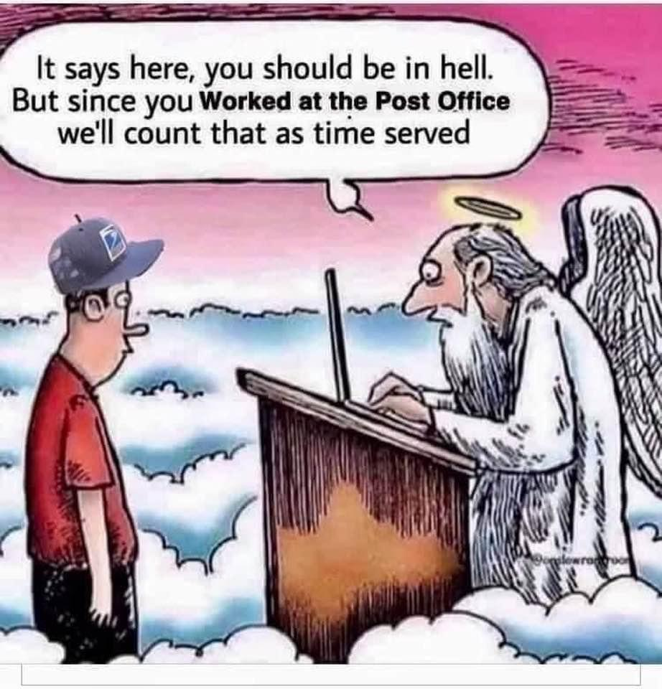
Welcome to New Members/Retirees and/or Service Veterans
Suzanne Halliday- Belleville
Gary Galloway - Belleville
George Messer - Belleville
Nancy Dobson - Utopia
Carol Ann Latoski - Barrie
Valerie Patterson - Barrie
Joanne McKean - Lindsay
Darla Bonner - Keene
Eunice Fairfield - Trent Lakes
Maureen Ginn - Kingston

Slide 11
NEW EASY STEPS TO UPDATE INFORMATION
https://heritageclub.ca/member-information-change/
New Form to update your information on our national website. It will be sent to me directly.
Hard Copy: Change of Address Notice
Name: Old Address: New Address: Phone# Email: Membership Dues: Self - $10.00 Couple - $20.00
Volunteer Hours:

Slide 12
Canada Post Stamp Launch of Female Indigenous Politician
Nellie Cournoyea stamp unveiling event: June 11, 1:30 pm (Mountain Time), Ulukhaktok, N.W.T.
Nellie Cournoyea (b. 1940) has devoted her life to fighting for Indigenous self-determination and Inuit empowerment. Selected as Premier of the Northwest Territories in 1991, she became the first Indigenous woman to head a provincial or territorial government in Canada. She played a key role in the discussions leading to the creation of Nunavut, and after leaving office in 1995, she served for 20 years as chair and chief executive officer of the Inuvialuit Regional Corporation. An Officer of the Order of Canada, Cournoyea is currently chair of the Nutrition North Canada Advisory Board and vice-chair of the Tuktoyaktuk Community Corporation.
Note: This launch seemed very appropriate after being in Alaska with the Northwest Territories being the other side of the border.

Slide 13
Recipe Corner Crisp-Keeping Coleslaw
Directions:
1. Shred the cabbage or chop it.
2. Slice the onion very finely and do the same with the green pepper.
3. Blend the other ingredients in a saucepan, bring them to a boil and let cool.
4. Mix the dressing with the greens and let stand in fridge for 24 hours before you serve it. Put it in a glass dish, not plastic or metal, and cover tightly.
5. Drain the dressing and save it to pour on whatever is left over and return to fridge. Continue using the dressing as you add more solids.
1 small head of cabbage
1 onion
1 green pepper
⅓ cup Water
1⁄4 cup vinegar
⅔ cup sugar
¼ tsp. Dry mustard

